Slide 1



Scripts for Hack5 tools

Slide 2
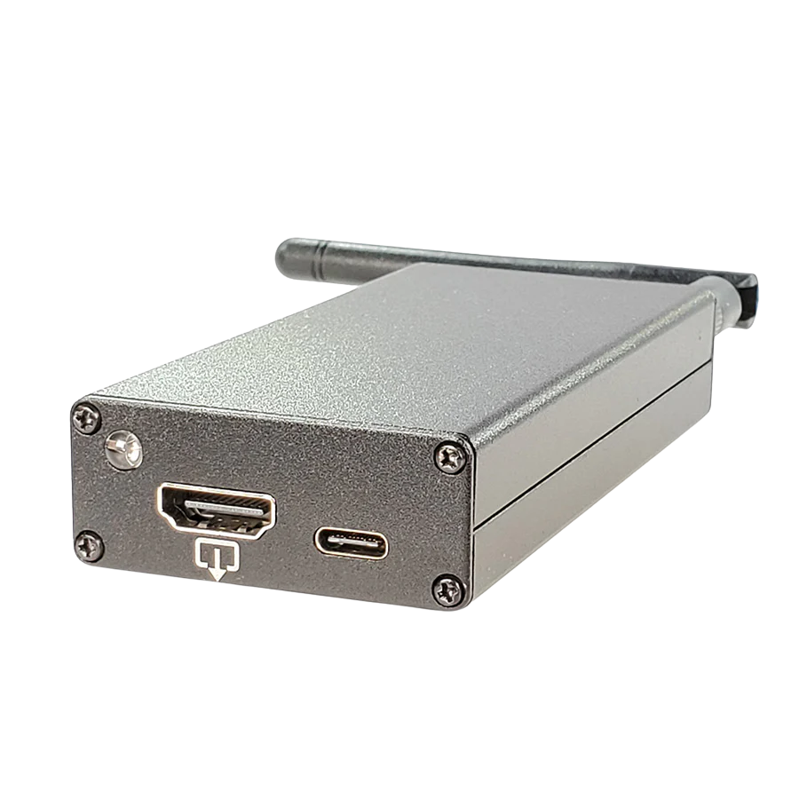
Screen Crab
Presented by Miłosz Obrębski

Slide 3



Screen Crab is a hacking tool developed by Hak5. Designed to appear as a harmless video adapter or dongle. It functions as an man-in-the-middle video proxy.
The device sits between the source device and the monitor, it allows for screen capture recording, remote live streaming of visual data over Wi-Fi, and spying on a target's on-screen activity without triggering any operating system alerts.
What the PC sees
Normal monitor
Reality
Evil proxy

Slide 4
Use cases:
- Remote grabbing of sensitive data
- Remote control when paired with for example Key Croc
- Recording videos
Author of this presentation is not responsible for any non educational use cases, only use the device within the law

Slide 5
Configuration
How to make it work?

Slide 6
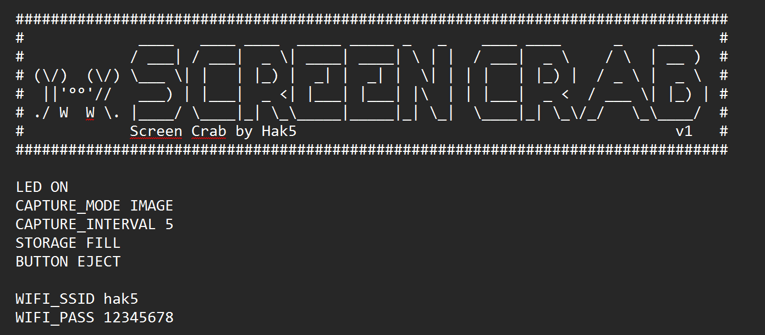
Screen crab after boot loads config file from the sd card. The most important thing is to configure the wi-fi, other settings were left as they were

Slide 7
C2 Cloud
Dedicated management solution
for hak5 devices

Slide 8
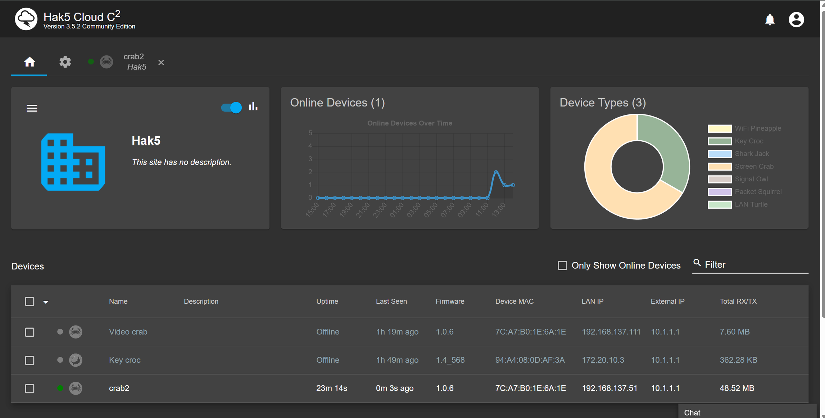

Slide 9
C2 Cloud interface allows:
- to configure the devices without using the sd
- to collect loot
- to remotely access target computer
- to read logs
- to see statistics eg. uptime
To add a device the device.config file is placed in the root directory of the device. This file is generated from the dashboard
C2 cloud is meant to be self-hosted on a public server which the Hak5 device can access

Slide 10
The script
Student id grabber

Slide 11
The script is written in python and uses api of C2 Cloud to fetch and process images
The main feature of the script is stealthily saving screenshots of student ids on pg login website.
Images are taken by default every 10s, the script downloads latest one and uses opencv to detect logo of PG to detect if the user is on the login website.
It is very easy to modify the search image

Slide 12
First we need to connect the device to the target computer. Video output from PC goes to Screen Crab and output of screen crab goes to the monitor
What the PC sees
Normal monitor
Reality
Evil proxy

Slide 13
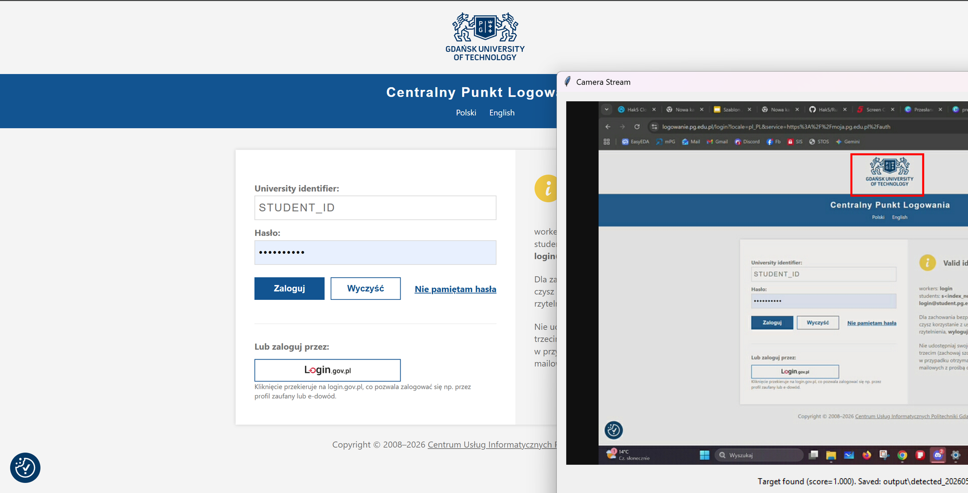

Slide 14
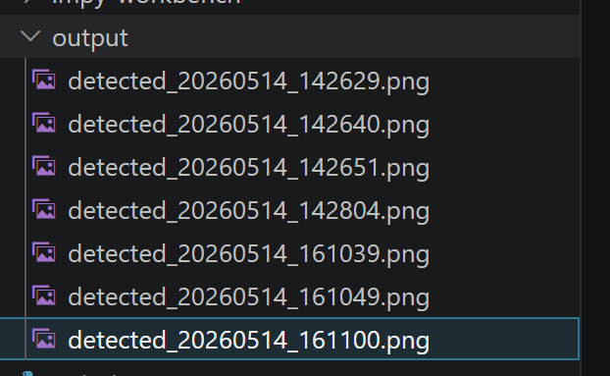
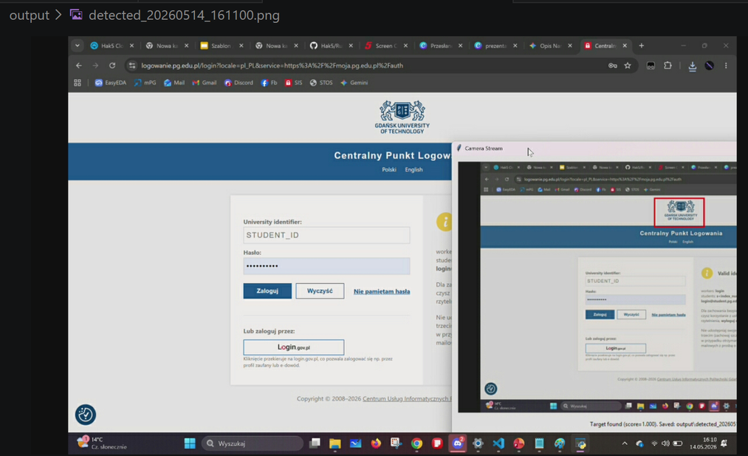
Once PG logo was detected in the image the script saved that image to disk for further analisis

Slide 15
THE END
Screen Crab
Presented by Miłosz Obrębski

